Slide 1
WORKPLACE COMMUNICATION SKILLS
Module Code and Version #
MANAGING MEETING 2

Slide 2
Topic & Structure of The Lesson
Conducting the meeting
Report writing

Slide 3
CONDUCTING THE MEETING

Slide 4


Slide 5
REPORT WRITING

Slide 6
The minutes of a meeting are . . .
the written record of a group’s discussion and activities.
legal documents as well as historical records of organization business.
a way to share what happens with members who don’t attend.
a way to prevent disagreement over member assignments and group decisions.

Slide 7
The Importance of Minutes
How essential was the meeting if it’s not worth recording?
Minutes will bring non-attendees up to speed, and remind attendees of directions taken
Good way to remind people of their assignments (action items)
Marking attendees (and those excused and/or absent) is a gentle nudge
Include time/location of next meeting

Slide 8
What to Include in the Minutes
Name of the group
Date and place of meeting
Names of attending members
Name of the chair
Names of absent members
Time the meeting was called to order
Time the meeting adjourned
Name of person preparing the minutes
Summary of discussion and decisions including action items

Slide 9
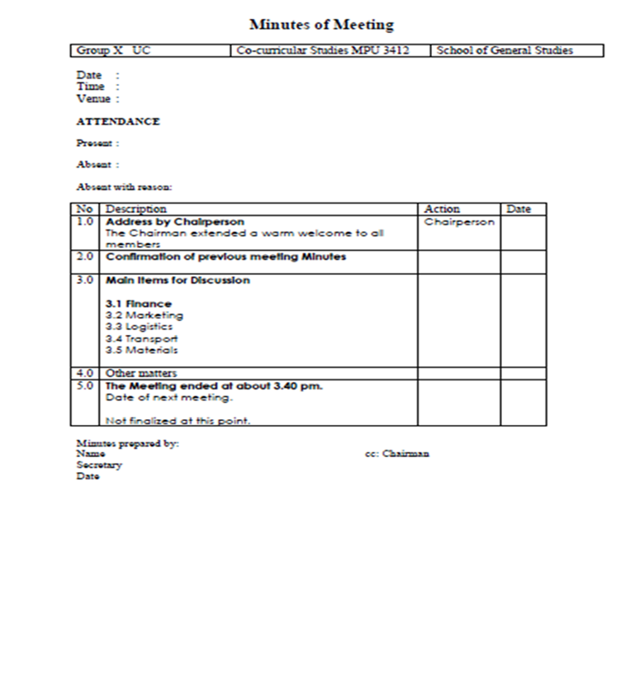
SAMPLE MINUTES OF MEETING

Slide 10
Activity
Students are required to conduct a meeting and prepare report writing based on earlier discussion

Slide 11
QUESTION AND ANSWER SESSION

